Slide 1
THE SIERRA LEONE CONSTITUTIONAL REVIEW COMMITTEE PROGRESS REPORT JULY 2013 – MARCH 2014
PRESENTATION BY:
A S SHEKU
SECRETARY TO THE COMMITTEE

Slide 2
BACKGROUND
The Eighty persons Constitutional Review Committee was constituted in July 2013 undertake an all inclusive and participatory process for the review of the 1991 Constitution of Sierra Leone in tandem with the Recommendations of the CRC submitted in 2008.
The overarching deliverable of this task is to have a finalized constitutional review process with a revised constitution presented to parliament for adoption.
To accomplish this object, the project Document jointly developed by GOSL and her development partners identified the following outputs:
Capacity of CRC members developed to undertake effective constitutional review process
Capacity of CRC secretariat to provide legal, research and administrative services to CRC developed
CRC Communication and messaging strategy designed and implemented
Civil Society led inclusive and informative civic education process completed
CRC led inclusive and transparent civic education and public consultation process completed
Enhance capacity of MPs, political parties and traditional leaders to effectively support and participate in the review process.

Slide 3
BASELINE, INDICATORS AND TARGETS
At the inception of the process the following baseline prevailed:
CRC and CRC Secretariat were in there formative stages;
Legal/ technical capacity of CRC members and secretariat staff was variable.
No CRC communication strategy or activities underway.
No CRC Civil Education and public consultation strategy was in place.
Variable capacity of CSOs, media and MPs to engage with Constitutional review process
By the end of the review process, it is envisaged that:
CRC members are capable of producing technically proper amendments and recommendations.
CRC Secretariat capable of providing high quality and timely services to CRC
Effective civic education undertaken to build knowledge of constitutional issues
Effective public consultation process undertaken to collect feed- back from across the Country.
Media responsibly reporting on constitutional issues.
MPs, women and youth specifically capacitated to engage constitutional process.
CSOs network is established and effecting participating in the constitutional process

Slide 4
YEAR 1 TARGETS
CRC agree on rules of procedure.
CRC agree on work plan.
CRC Secretariat set up and working to provide technical support to members.
CRC website developed and sustained.
CRC civil education and public consultation strategy developed.
CSOs and trained to undertake civic education.
Media trained on constitutional reporting.

Slide 5
WHAT HAS BEEN ACCOMPLISHED SO FAR
Constitutional Review Committee Progress Report 2013/ 2014
Activities | Description | July | August | September | October | November | December | January | February | March
CRC Launched | President Koroma launched the CRC at the Miatta Conference Centre in Freetown. | 30th
 | Members of the CRC announced | 30th
Inaugural Meeting | 1991 Constitution and 2008 CRC Report distributed |  | 6th
2nd meeting | 2nd meeting- CRC confirmed its Mandate and project document distributed to members |  |  |  | 14th
3rd meeting | CRC reviewed the draft rules of procedure for meetings, work methodology and work plan |  |  |  | 29th
4th meeting | Rules of procedure and work plan approved |  |  |  |  | 12th
5th meeting | CRC sub- committees and TORs approved |  |  |  |  |  | 3rd
6th meeting | CRC met with the CTA and selected sub- committees |  |  |  |  |  | 17th
7th meeting | Secretariat held inaugural press conference |  |  |  |  |  | 23rd
Printing of Constitution and CRC 2008 report | 500 copies each were printed for distribution to press and local authorities |  |  |  |  |  | 23rd
Visits | Secretary CRC’s visit to the regions
 | Distribution of copies of the Constitution and Report
Website and Newsletter | Website and first news letter launched |  |  |  |  |  | 28th
Technical Workshop for CRC | Two days Technical session was held to capacitate CRC members on the CR process. |  |  |  |  |  |  | 7th
 | Task and Out Reach strategies developed for sub- committees |  |  |  |  |  |  | 7th
Media engagement on Constitutional Review process | One day session was held with sixty media practitioners to strengthen capacity in constitutional reporting |  |  |  |  |  |  |  |  | 11th
CRC planning session | CRC Plenary session held to consolidate sub- committee outreach and public consultation plans |  |  |  |  |  |  |  |  | 14th
CRC Plenary session | CRC held plenary session to prepare for outreach activities |  |  |  |  |  |  |  |  | 28th

Slide 6
OTHER ACTIVITIES
Secretariat has been set up.
Equipment and furniture procured for the review process.
Eleven vehicles have been procured by Government to provide mobility for CRC and they will be delivered today.
Eleven Researchers have been assigned to provide technical support to CRC.
Along the fringes of its work, CRC has supported CSOs and other governance institutions to host several activities to command attention to the review process and clarify issues in order to encourage citizen’s partition.

Slide 7
NEW WORK PLANS

Slide 8
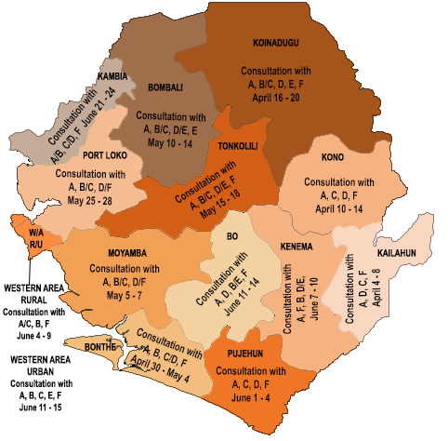
Geographical Outreach Consultation Plan Information, Education and Communication Sub-Committee
Code | Target Group/Stakeholders | Task/Consultation Theme
A | Ministries of Education, Youth and Sports, Information and Communication | Civic Education (includes sensitization on radio, television, drama, music) Consultation with different institutions on educational constraints (Students, Lecturers, Teachers), their contribution towards the constitutional review. Meeting various communities on the importance of education of the girl child. Consultation with traditional leaders, youth groups, women, children on their needs on the aspect of education. Debate on freedom of information with journalists, the print and electronic media in different communities Meeting stakeholders on their contribution towards the CRC
B | City Council schools, Missionary assisted schools and council schools in the provinces
C | Institutions includes Universities and Tertiary Institutions
D | The Council of Principals and Head Teachers, Professors
E | Sierra Leone Teachers Union, West African Examination Council, Student Unions, Sierra Leone Deaf and Dumb Association
F | Independent Media Commission, Sierra Leone Association of Journalist, Print and Electronic Media, National Telecommunication
G | Locals in different communities (including Youths, Children, Trade Union)
H | Religious and Traditional

Slide 9
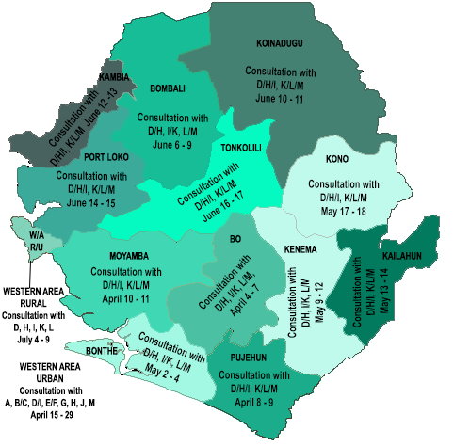
Geographical Outreach Consultation Plan Legislative Sub-Committee
Code | Target Group/Stakeholders | Task/Consultation Theme
A | Parliament | Representation of the people section 31-39 of the 1991 constitution
B | PPRC | Composition of parliament section 73-83 of the 1991 constitution
C | NEC | Bicameralism (a lower and upper chamber parliament)
D | Local Councils | Non-appointment of parliamentarians as ministers
E | Ministry of Political Affairs | Gender and disability representation.
F | A.G’s Office
G | Law Reform Commission
H | Inter Religious Council
I | Traditional Leaders
J | Bar Association
K | Civil Society Groups
L | Educational Institutions
M | Political Parties

Slide 10
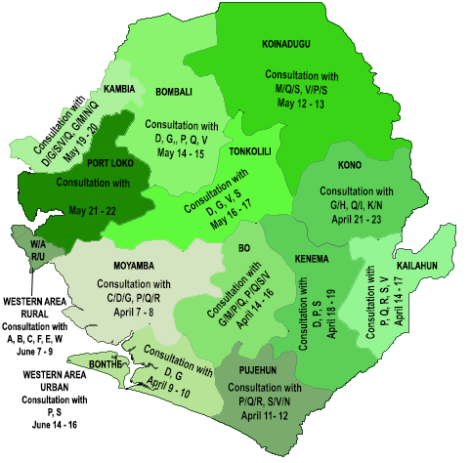
Geographical Outreach Consultation Plan Local Government and Other Ancillary Branches Sub-Committee
Code | Target Group/Stakeholders | Task/Consultation Theme
A | Ministry of Local Government | Active participation in discussions about the Constitution
B | Director of Rural Development
C | Inspector of Local Government | Service delivery No provision in the Constitution for decentralization Financial decentralization Council of Chiefs not effective
D | Traditional Leaders
E | Head of Civil Service
F | Director of Decentralization
G | Mayors of Councils
H | Ward Committees
I | Court Staff of Local Councils
J | Core Staff of Local Councils
K | Provincial Secretaries & Officers
L | Local Councilors
M | District Officers
N | Director Rural Development
O | Councilors
P | Chiefs
Q | Chief Administrator | Direct participation of PC or Traditional Leaders in Legislative Process
R | District Youths
S | Advisory Committees
T | Treasury Clerks
U | Women’s Group
V | Director General HRMO
W | Devolving Ministries, Departments & Agencies

Slide 11
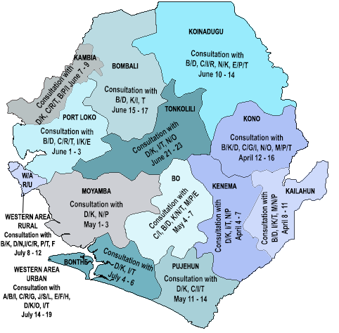
Geographical Outreach Consultation Plan Research Sub-Committee
Code | Target Group/Stakeholders | Task/Consultation Theme
A | Cabinet/Presidency | Executive Government Natural Resources Legislative Judiciary Local Government Human Rights Information Education Communication
B | Political Parties
C | Civil Society Groups
D | Traditional Leaders
E | Tertiary Institutions
F | Independent Experts
G | Trade Unions
H | Diaspora
I | Media
J | Legislature
K | Local Councilors
L | Judges
M | Students
N | Land Owners
O | Mining Companies
P | Local Youth Groups
Q | Human Rights Commission
R | NGOs
S | Justice Sector Institutions
T | Community

Slide 12
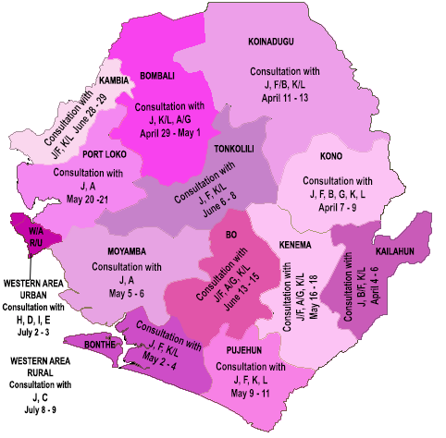
Geographical Outreach Consultation Plan State Policy and Human Rights Sub-Committee
A | Educational Institutions/ Students/ Academic staff, Associations/ Experts | Bail, Undue delay, Death Penalty, Legal Aid, Justiciability, Minority Rights, Discrimination, Unlawful Detention, Freedom of Speech and Freedom of the Media, Freedom of Movement and Assembly, Harmful Cultural Practices, Prison conditions, Police powers, Abortion, Torture, Sexual and Gender-Based Violence, Teenage Pregnancy. Freedom of Speech and Freedom of the Media Bail, Undue delay, Paucity of benchers, Legal Aid, Death Penalty, Prison Conditions, Discrimination, Sexual and Gender-Based Violence, Minority Rights
B | Political Parties
C | Human Rights Commission
D | Independent Media Commission, Sierra Leone Association of Journalists and Society for Democratic Initiatives
E | Judiciary, Ministry of Justice, Justice Sector Coordination Office, Law Reform Commission
F | Legislators and Local Councilors
G | Network of Human Rights Defenders
H | Prisons Department
I | Sierra Leone Police | Unlawful arrest and detention, CID Treatment, Right to Assembly/Procession, Right to life, Crowd Control
J | Traditional and Religious Leaders | Harmful cultural practices, Gender-Based Violence, Discrimination, Land rights, Chieftaincy Rights, Marriage, Succession and Minority Rights
K | Women’s Groups | Discrimination, Sexual and Gender-Based Violence, Property Rights, Harmful Cultural practices, Land rights, Marriage, Succession, Teenage pregnancy
L | Youth Groups | Discrimination, Land Rights, Employment, Police Powers (Arrest and Detention), Minority Rights

Slide 13
CHALLENGES
Funding remains CRC ‘s greatest challenge.
Inadequate technical and managerial capacity at CRC Secretariat.
Serious space capacity constraint
Limited equipment
Unmotivated staff

Slide 14
THE END
THANKS FOR YOUR ATTENTION

