Slide 1
Optical Fiber Networks
“Now and The Future”.
Yussif Fofanah
November, 2013
Notes:
Depending who you ask on the history and origin of Fiber Optic itself, backbone networks have been around since the 1800s, but industry wide experts do believe one thing in common that it was developed and placed in the market in the 1950s. A U.S based company AT&T began using fiber optics as a replacement for copper based systems as the first commercial applications for fiber optics and took place in Chicago.
The next few slides will explain in brief the benefits of this technology, its advantages, disadvantages, handling methods, planning, installation, testing and evaluation. This information is no way intended the entire procedure on this topics that I have just mentioned but it will create an eye opener to someone that has little or no knowledge on the technology itself.

Slide 2

Notes:
These four bullet points are crucial to touch when discussing the elements of optical transmission as the need for speed, size and performance has been increased in our daily lives. It almost seem as the more we get the more we want and nothing is ever good or fast enough. We need to communicate faster via telephone, email, newsgroups, web access etc. The need to entertain ourselves has become much more in demand.
For all these to be a way of life, backbone networks have to be found on a reliable and fast platform such as fiber optic. Planning is the key to a successful design that will bring ease during installation as the product itself is fragile, expensive and needs great attention when working with it or anything that has to do with it.
Networks that are gradually migrating to these technology or for the first time been deployed with it have certain similarities with the ones that are been phased out but there are several differences that we will touch on as we go along this brief presentation. Those differences makes all the difference for society to benefit e.g. transmission of video signals and digital data over conventional copper cables cannot yet comply wit the constantly growing demand of our lifestyle.
Testing and Evaluation is a topic that requires great attention in the process as it might sometimes be too late if the results of a completed install turns out to be way off what you expected to be, so during the planning stage you must consider the “what if” not as a backup plan but just incase unforeseen events occurred way at the end of the final testing stage.

Slide 3

Notes:
These four bullet points are crucial to touch when discussing the elements of optical transmission as the need for speed, size and performance has been increased in our daily lives. It almost seem as the more we get the more we want and nothing is ever good or fast enough. We need to communicate faster via telephone, email, newsgroups, web access etc. The need to entertain ourselves has become much more in demand.
For all these to be a way of life, backbone networks have to be found on a reliable and fast platform such as fiber optic. Planning is the key to a successful design that will bring ease during installation as the product itself is fragile, expensive and needs great attention when working with it or anything that has to do with it.
Networks that are gradually migrating to these technology or for the first time been deployed with it have certain similarities with the ones that are been phased out but there are several differences that we will touch on as we go along this brief presentation. Those differences makes all the difference for society to benefit e.g. transmission of video signals and digital data over conventional copper cables cannot yet comply wit the constantly growing demand of our lifestyle.
Testing and Evaluation is a topic that requires great attention in the process as it might sometimes be too late if the results of a completed install turns out to be way off what you expected to be, so during the planning stage you must consider the “what if” not as a backup plan but just incase unforeseen events occurred way at the end of the final testing stage.

Slide 4
Contents
1
Broadband Access - What & How?
2
Planning & Design
3
Optical Communication Principles
4
Monitoring, Evaluating & Training
Notes:
These four bullet points are crucial to touch when discussing the elements of optical transmission as the need for speed, size and performance has been increased in our daily lives. It almost seem as the more we get the more we want and nothing is ever good or fast enough. We need to communicate faster via telephone, email, newsgroups, web access etc. The need to entertain ourselves has become much more in demand.
For all these to be a way of life, backbone networks have to be found on a reliable and fast platform such as fiber optic. Planning is the key to a successful design that will bring ease during installation as the product itself is fragile, expensive and needs great attention when working with it or anything that has to do with it.
Networks that are gradually migrating to these technology or for the first time been deployed with it have certain similarities with the ones that are been phased out but there are several differences that we will touch on as we go along this brief presentation. Those differences makes all the difference for society to benefit e.g. transmission of video signals and digital data over conventional copper cables cannot yet comply wit the constantly growing demand of our lifestyle.
Testing and Evaluation is a topic that requires great attention in the process as it might sometimes be too late if the results of a completed install turns out to be way off what you expected to be, so during the planning stage you must consider the “what if” not as a backup plan but just incase unforeseen events occurred way at the end of the final testing stage.

Slide 5
Broadband Access
What & How
Broadband Access
High Def TV, Internet Gaming, Medical Data, E-Business, E-Govt, Cloud Computing, Smart Phones etc.
Supports Access to different types of technologies – Long Haul & Back Haul, FTTX, WAN, LAN.
Difference between technologies enables different applications.
Prospect of Broadband
High Power Laser and Precision , Cutting, Etching of Surface,
Revenue generators today are Telephony, Data & Video.
With higher broadband, all 3 applications can be bundled & delivered as one.
Notes:
As far as high speed internet connections are concerned, broadband access has become the agent that has revitalized the industry so fast that industry experts think if one fails to catch up events of yesterday, the ones of today will be too late to look at let alone start worrying about tomorrow’s. Broadband speeds at 2Mbps speeds seems just enough when one reflects two decades ago how we communicate using 56kbps which we thought was good enough.
Technologies that supports these infrastructure compete so service providers can support the demand that is driving the market in making sure quality of service takes center stage as they deliver bundle services to support voice, video & data applications all in one at the same time.

Slide 6
Planning & Design
What’s Required
Identify CO
Conduct
Survey
Calculate
losses
These Key Points
Cable
Type
Pre-Test
&
Run Cable
Identify
Routes
Notes:
In this slide, the key points to take into consideration are listed. Planning is a very important factor to a successful and worry free backbone infrastructure installation. Looking at these points clockwise, the first task is to visit and identify the Central Office (CO) which will be your source point of connection. Start documenting everything and anything that will help you in your route plan. One visit to the CO is never enough to gather and familiarize yourself with points of entry and source route path or paths. Then conduct a survey from your findings with the staff or contractors associated with the CO and document as you go.
At this point you should be able to know what type of fiber cable you need and how many strands needed for the project but hold on purchasing just yet. Identify your route from source to your planned destination and consider the unexpected and plan ahead if during the project you have to alter your route as originally planned. Then from your route plan calculate how many splices you will perform along the way and determine that entire budget lose and see it meets industry standards, national and local codes.

Slide 7
Planning & Design – Cont.
Installation
Overhead Formation
Strung from poles.
Along power lines.
Proper Equipment.
Follow industry codes.
Occupational Safety.
Underground Formation
Pulled through ducts & conduits.
Calculate Pulling tensions
Pre-install pulling line
Lubricant
Pull length
Conduit & duct size
Cable
Enclosures
Pigtails / Form factors
Documentation

Slide 8
Optical Communication
Transmitter
Light Source
Principles
Connector
ST, SC,FC, LC
Medium
Optical Fiber
Receiver
Photo Detector
Source to Destination
Notes:
The Principle of optical communication is to transmit a light signal through an optical fiber to a distant receiver using four components.

Slide 9
Monitoring, Evaluating & Training
National Achievement
Red Carpet
Training
National Asset
Evaluating
Stake Holders
Monitoring
Local or National Experts

Slide 10
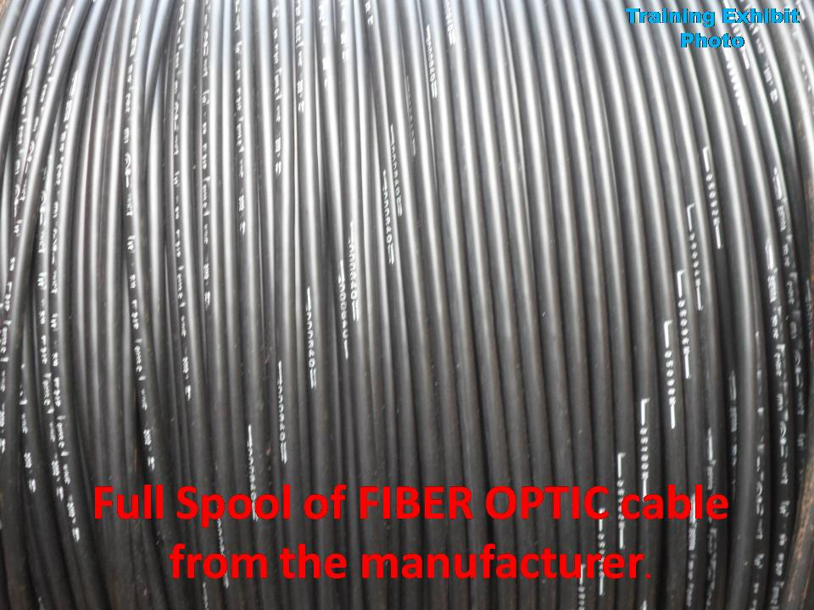
Diagram

Slide 11
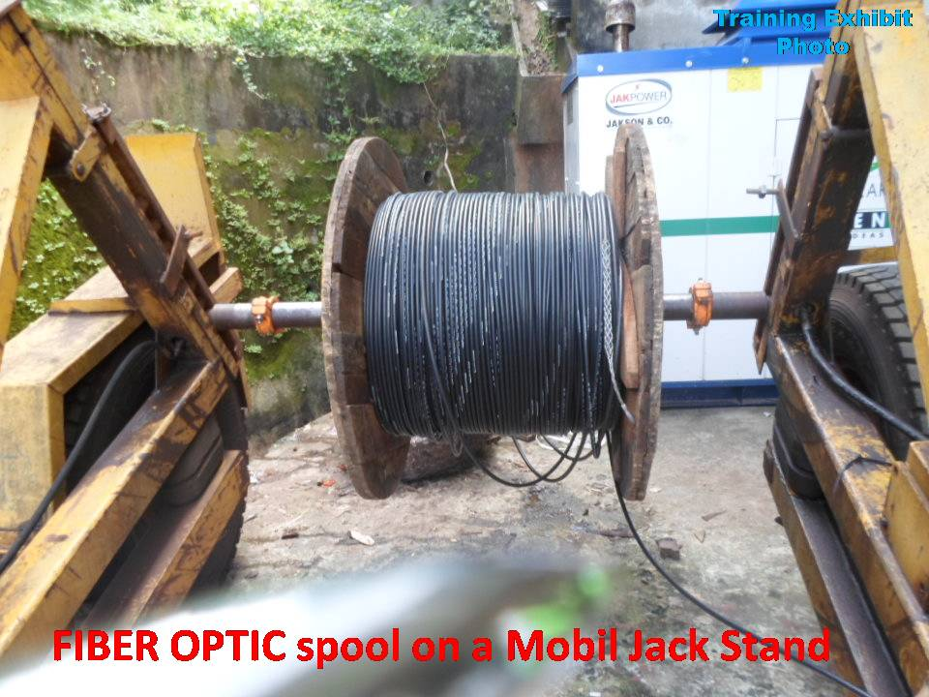
Diagram

Slide 12
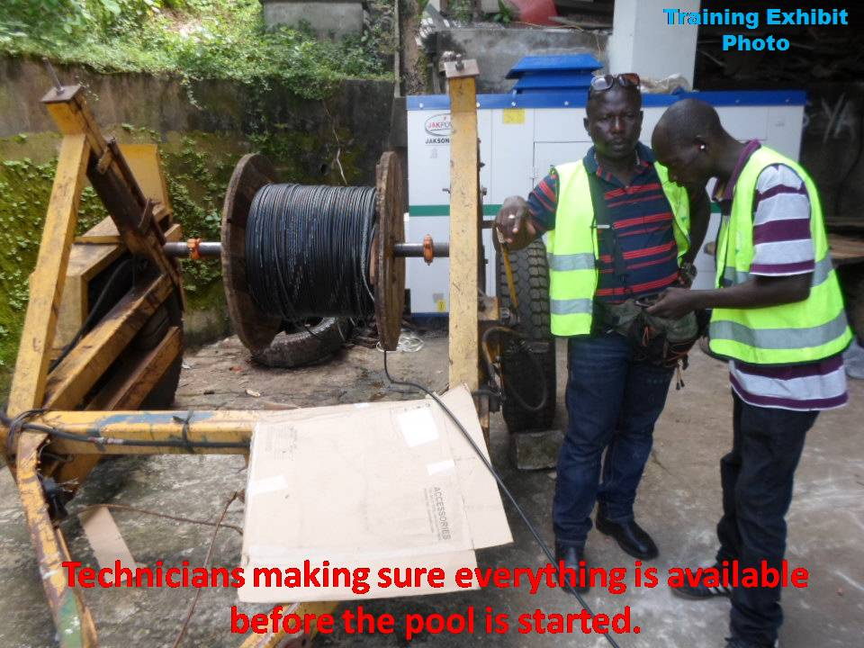
Diagram

Slide 13
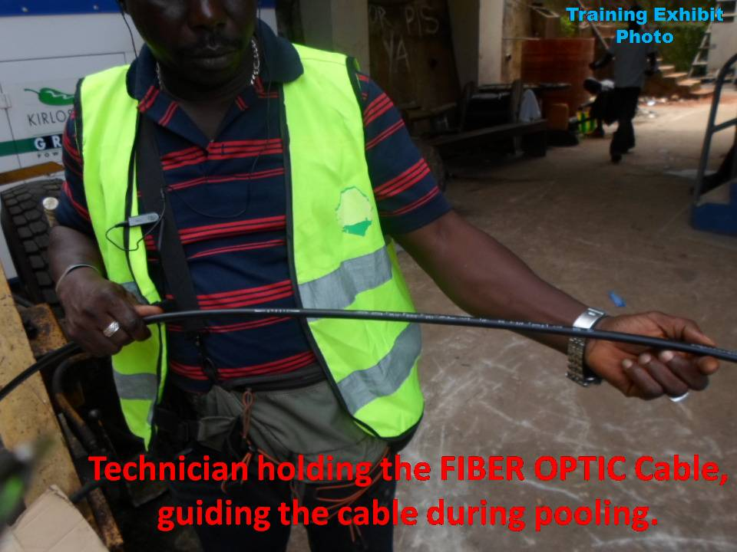
Diagram

Slide 14
Reel Data Sheet
Customer Oder Number
Factory Reel Number
Customer Job Number
Manufacturer Code and Count
Customer Reel Number
Cable Length
Beginning and End Marking
Ship Date
Weight of Cable and Reel
Manufacturer’s Name
Bar Code
Shipment Destination

Slide 15
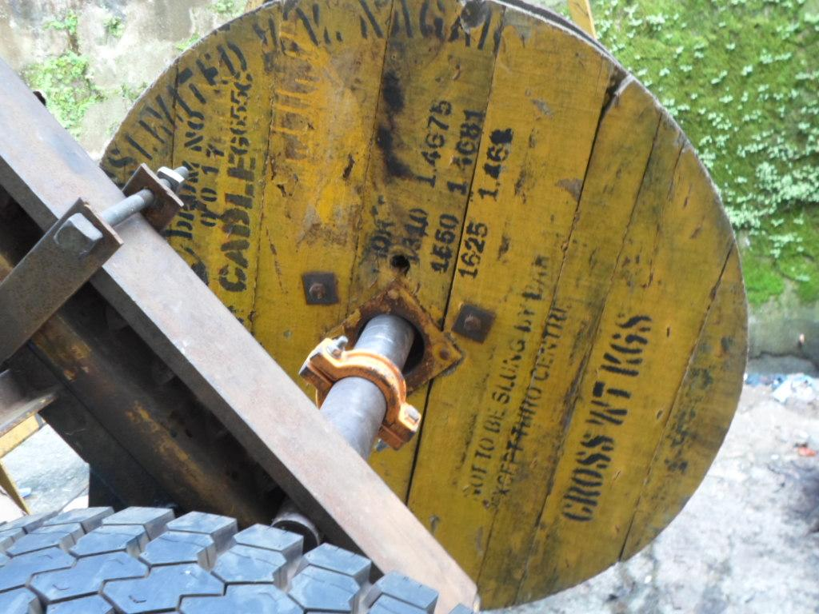
Diagram

Slide 16
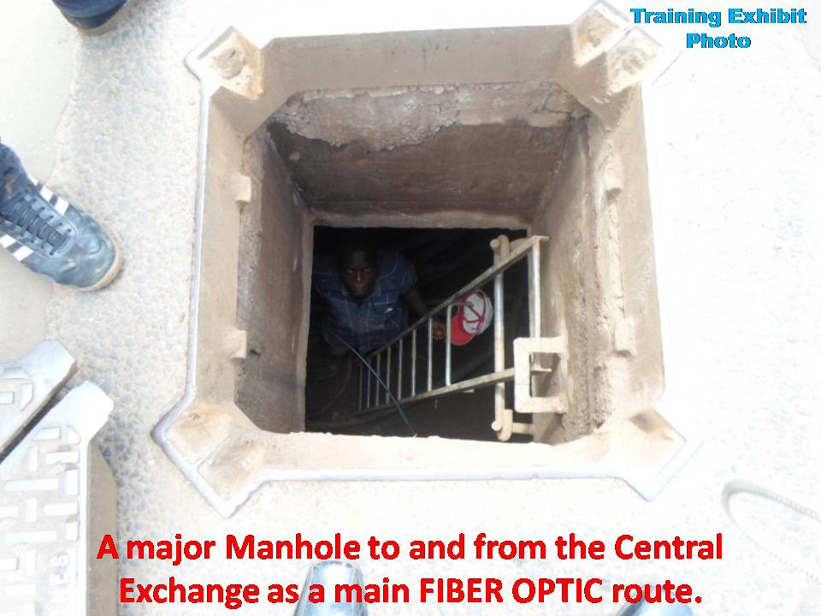
Diagram

Slide 17
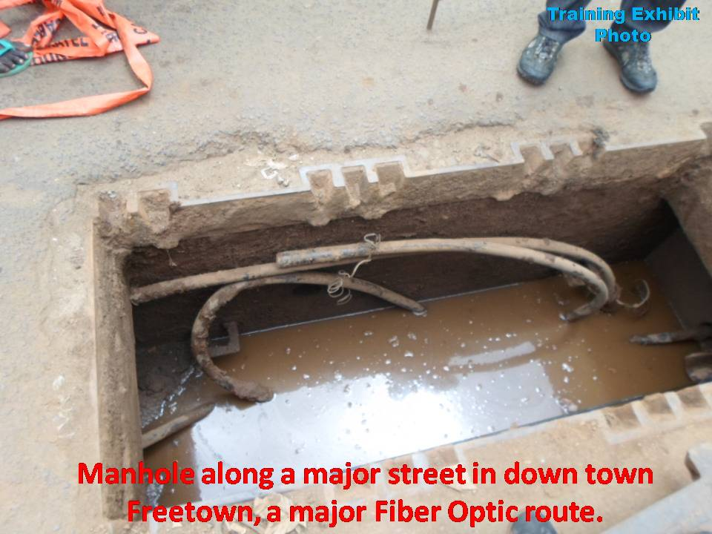
Diagram

Slide 18
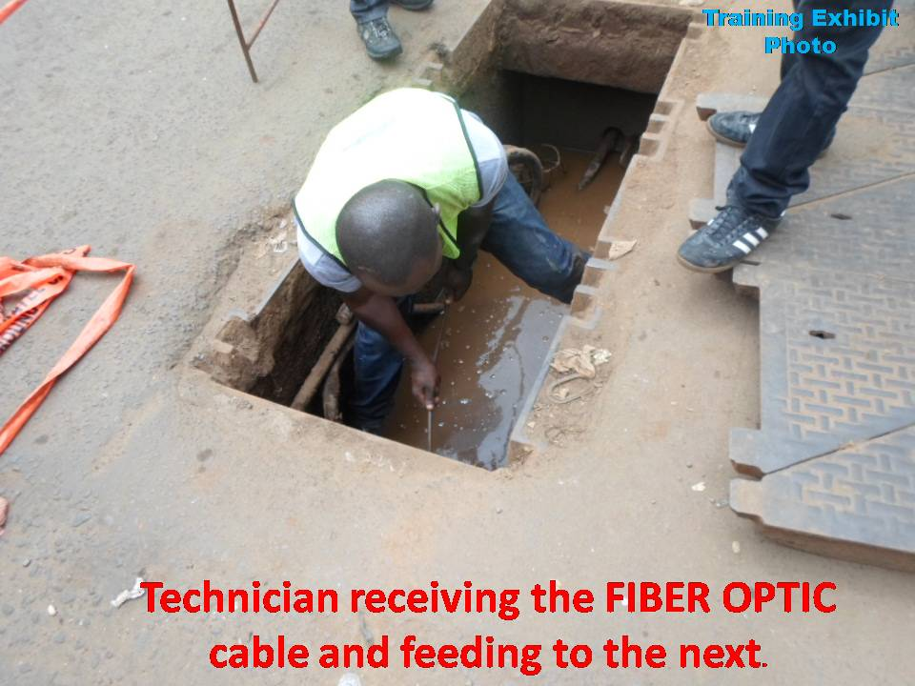
Diagram

Slide 19
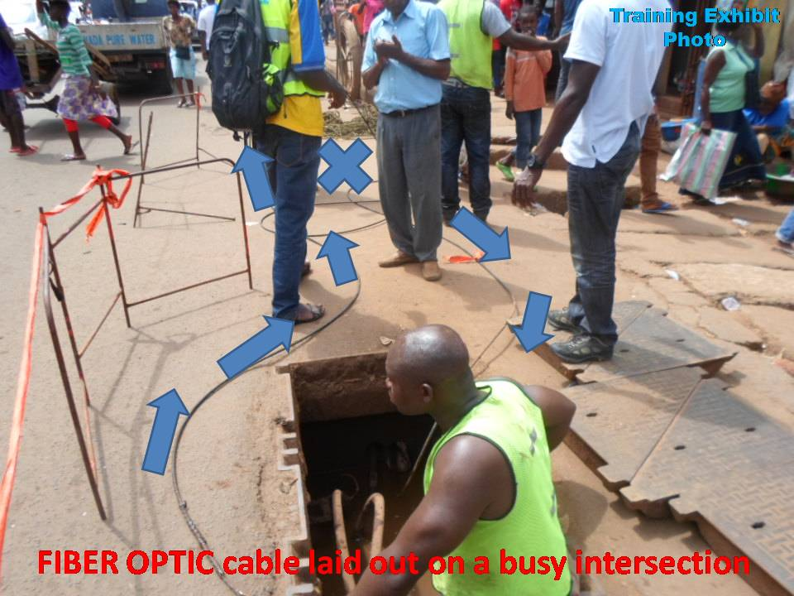
Diagram

Slide 20
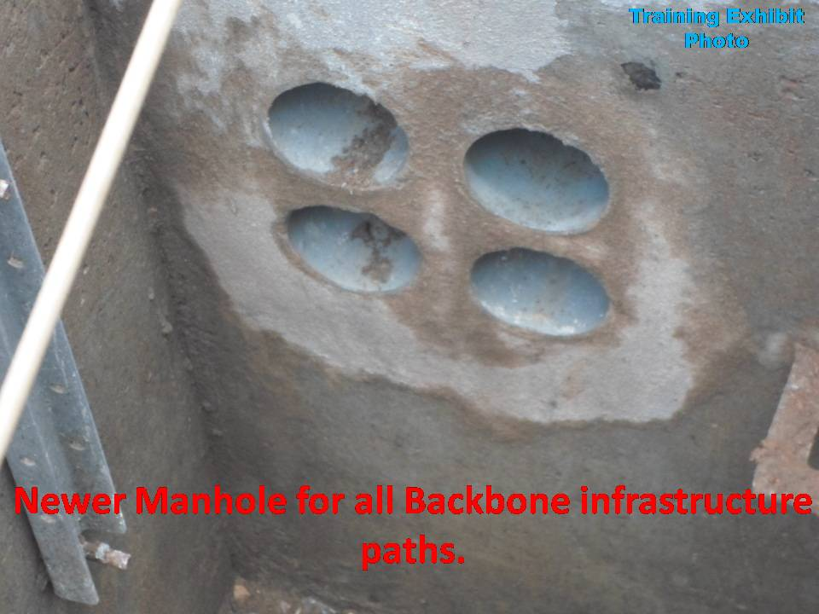
Diagram

Slide 21
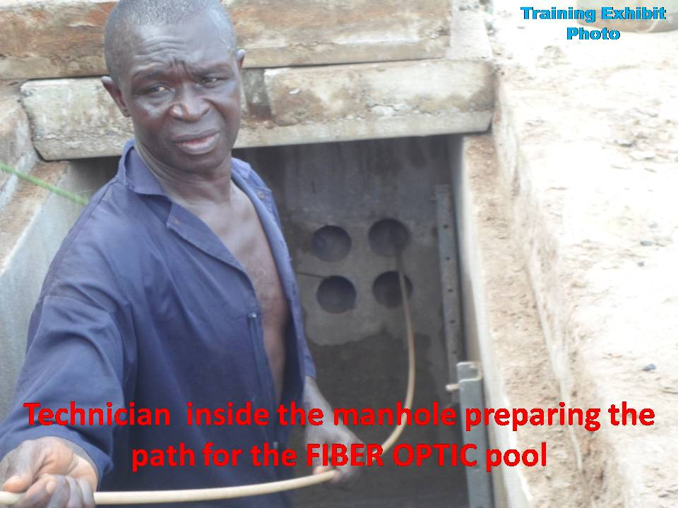
Diagram

Slide 22
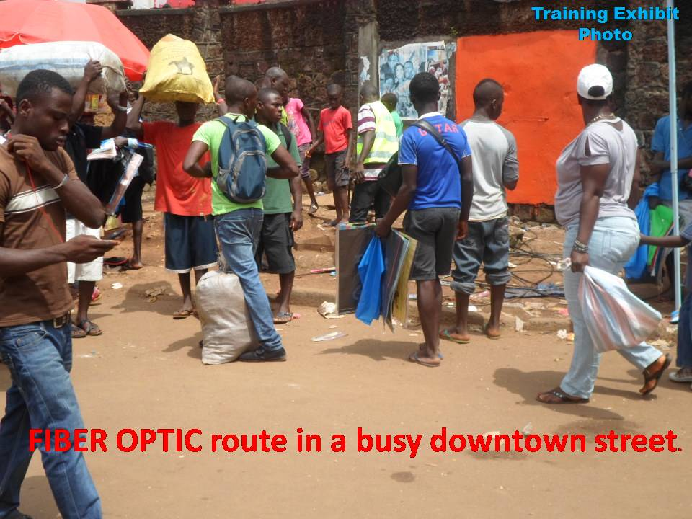
Diagram

Slide 23
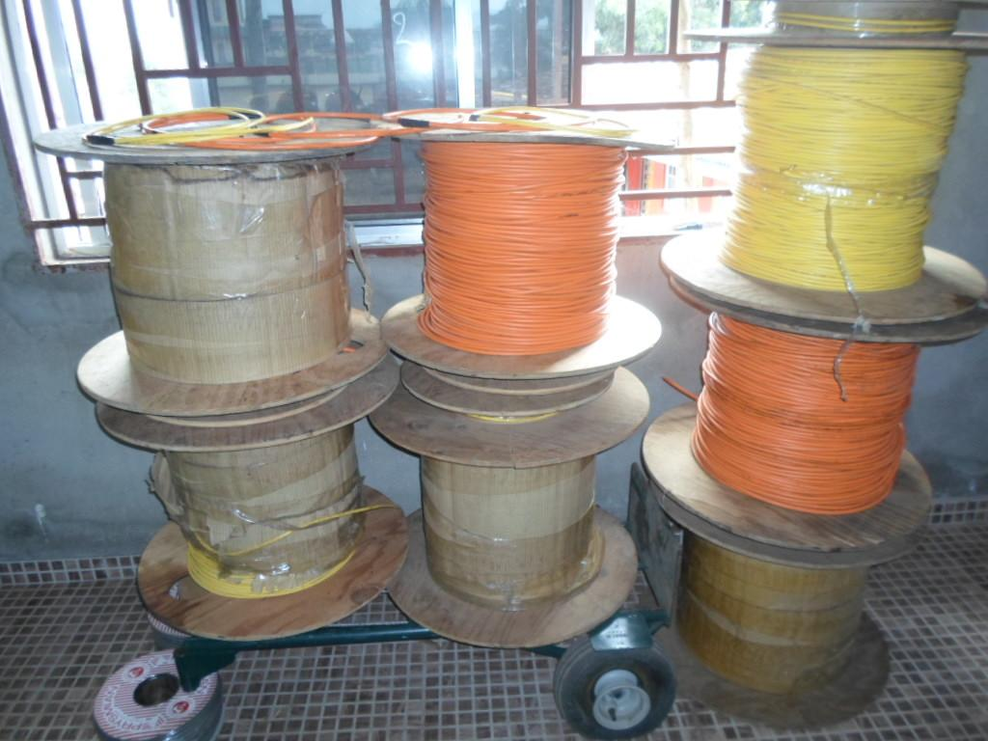

Slide 24

Yussif Fofanah of Teleficient Communication (center) with VP Alhaji Sam Sumana discussing the status of the ACE FIBER OPTIC connection to be landed……
Courtesy of The Patriotic Vanguard online newspaper 6/20/2009 – Washington DC

Slide 25
Thank You !

Slide 26

Questions

